Slide 1
Software Engineering Individual Project
Tiles
Week 4 Presentation
- Saurabh Pathak

Slide 2
Description
The game will present a 2X2 matrix of tiles.
Each tile will have a unique number or a pattern hidden behind it.
Each unique number/pattern exists twice in the matrix.
Once the player taps a tile, it flips and shows the pattern behind it.
The player has to match (by tapping consecutively) two tiles with same number/pattern hidden behind them.
If you match two tiles with different pattern, both the tiles will rotate and hide the pattern behind them.

Slide 3
core elements
2D matrix of tiles
Timer as per level
Option whether pattern exits twice or thrice
Patterns which will get complicated as per level
Retaining last state of the game

Slide 4
Additional elements
3D view of tiles
Multiplayer feature
Fingerprint authentication

Slide 5

Appearance and interaction

Slide 6
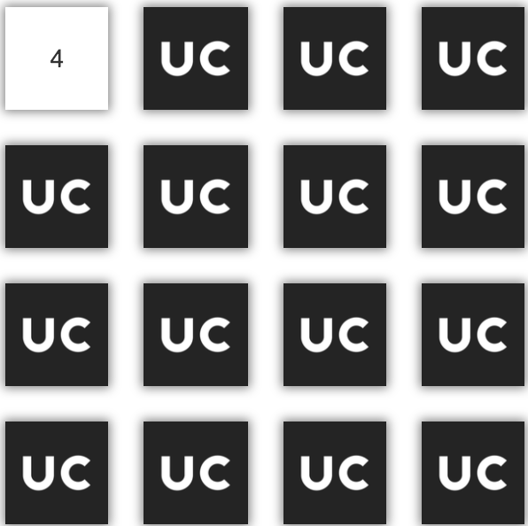
Appearance and interaction

Slide 7
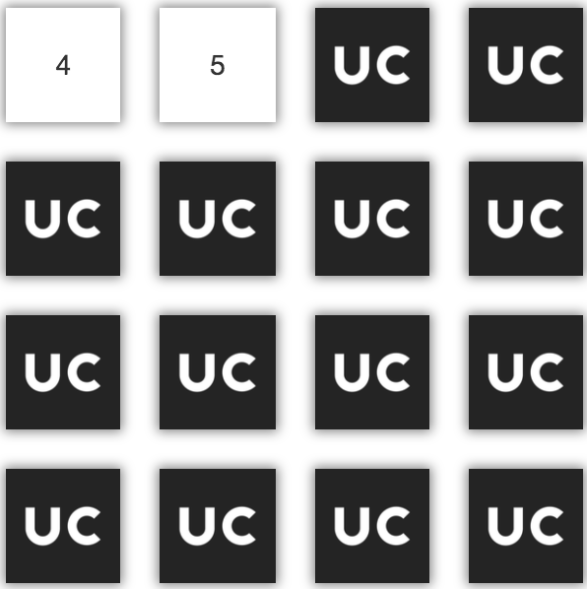
Appearance and interaction

Slide 8
Appearance and interaction

Slide 9
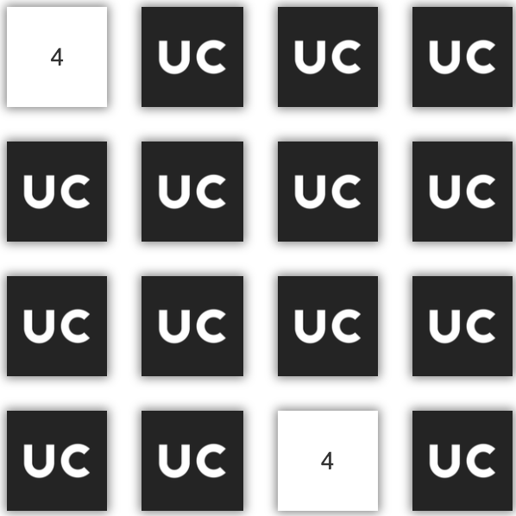
Appearance and interaction

Slide 10
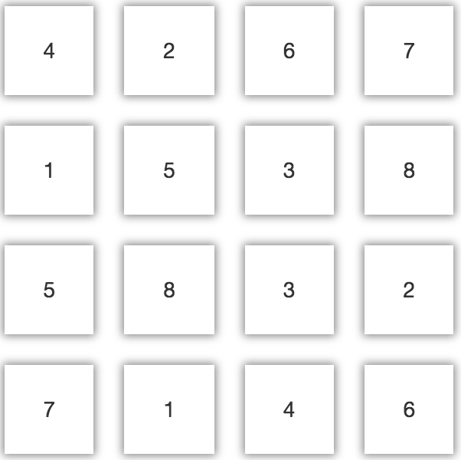
Appearance and interaction

Slide 11
Thank you!

